Slide 1
Reclaim
Home
Money
Community
Rights
Concept & Bridge Funding Request
Shaun Page
January 2026

Slide 2


It’s official: We’re in crisis

Slide 3
Has the world has gone mad?
Widespread loss of faith and trust in institutions
Misinformation and collapse of reality
Societal, economic and political polarization
Extreme weather events
Bottom line:
Resignation replaces Participation

Slide 4
The Gap
High stress. Low control.
People have responsibilities but no operating system.
People have protections, but no practical way to use them.
Help exists, but it’s fragmented and expensive.
Bottom line:
The gap isn’t intelligence. It’s tools and structure.

Slide 5
What that means in reality
Cost of living increases
Pay-to-play legal system
Communities broken
Things break at the worst times
Bottom line:
We must address the “Crisis of Connection”

Slide 6
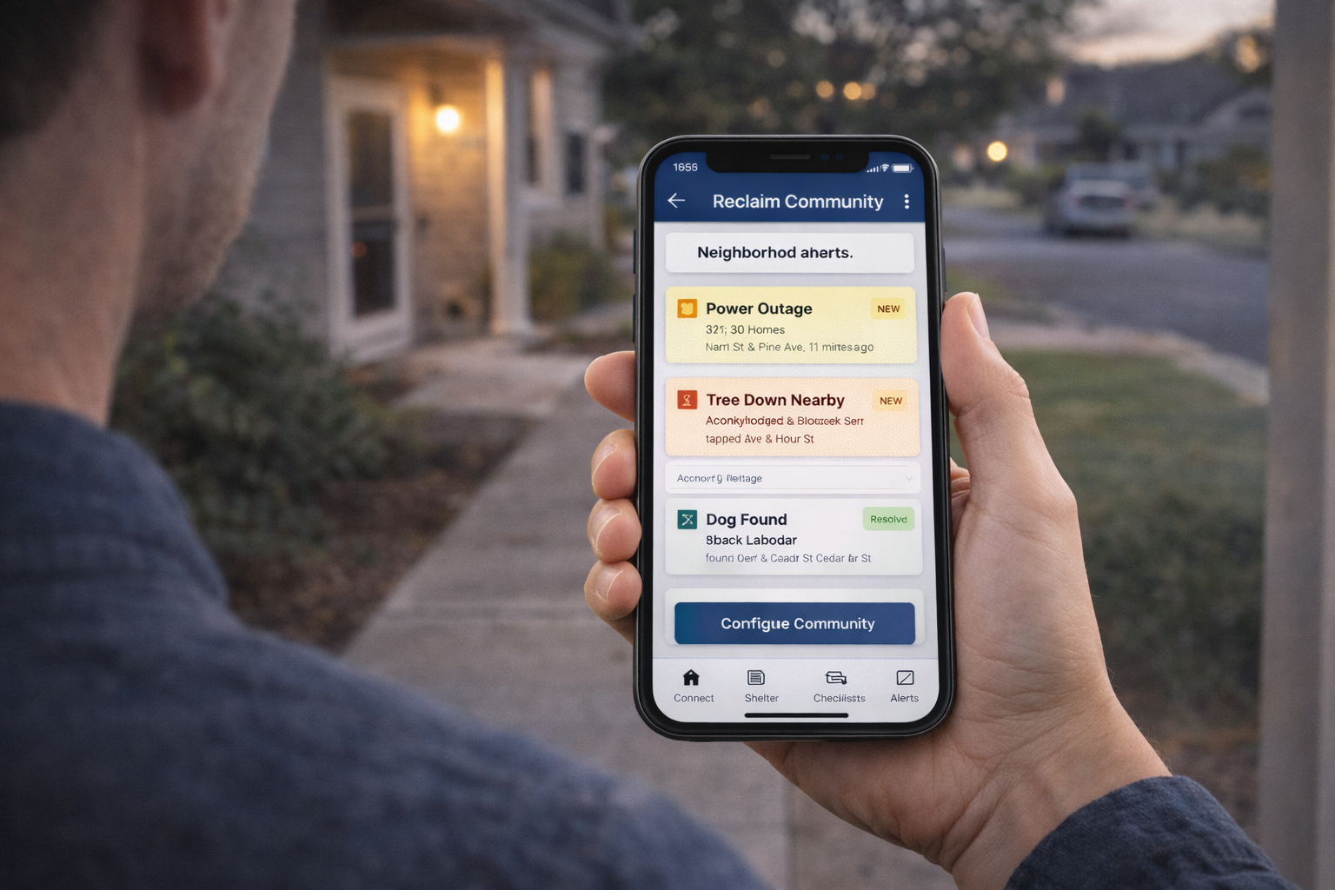
Reclaim:
Live happier

Slide 7
Product architecture
Four modules. One platform.
Reclaim Home — Proactive. Preventable. Prepared.
Reclaim Money — Make every dollar count
Reclaim Rights — Put the system to work for you
Reclaim Community — coordination, not surveillance
Bottom line:
Choose your starting point

Slide 8
Reclaim Home
Prevent the Surprise Failure
Home asset list: systems, appliances, warranties, service history.
Proactive maintenance schedules + reminders + practical checklists.
Provider log, receipts, photos, before/after evidence in one place.
Insurance coverage integration
Outcome:
Fewer emergencies. Lower total cost. Less stress.

Slide 9
Reclaim Money
Stop the Silent Drain.
Detect subscriptions, recurring charges, and duplicate services.
Flag spikes and anomalies in utilities/telco versus your history.
Cancellation and dispute workflows with a clean audit trail.
Track outcomes and escalation steps so issues don’t die in email.
Outcome:
Keep more of what you earn — without constant vigilance.

Slide 10
Reclaim Rights
Put the legal system to work for you
Timeline builder from messages, documents, photos, and notes.
Evidence vault with tagging and fast retrieval.
Draft support for letters, complaints, declarations, and forms (user review).
Deadlines + workflow checklists to prevent mistakes and missed steps.
Outcome:
Stop getting buried. Operate calmly, correctly, and on your terms.
Tools and workflow only — not a law firm, not representation.

Slide 11
Reclaim Community
Build your own network
You choose who sees what - leverage existing door camera infrastructure
Opt-in alerts for safety incidents, outages, scams, and shared local risks.
Simple coordination: what happened, where, status, and what to do next.
No law-enforcement workflow. No surveillance-by-design.
Transparent sharing controls (who shared what, with whom, and when).
Outcome:
Real community connection through practical shared action

Slide 12
Why now?
Household costs and complexity are rising.
People are overwhelmed; systems assume the opposite.
Resignation has replaced participation.
Urgent need to address the “Crisis of Connection”
Bottom line:
The time for household control infrastructure is now.

Slide 13
Why Reclaim wins
Household-first, Community-first, Not Institution-first.
Modular adoption lowers resistance and improves retention.
Immediate ROI wedge (Reclaim Home & Reclaim Money).
Reclaim Rights creates leverage through documentation and process.
Reclaim Community brings us together
Bottom line:
Reclaim earns trust first, then expands.

Slide 14
Competitive landscape (high level)
donotpay.com: consumer workflows for day to day tasks
    Reclaim: not a legal template solution; not an AI lawyer. Reclaim helps you navigate
LegalShield: a lawyer referral service
    Reclaim: integrated, modular control platform built for real life.
HomeShield: single-feature apps; no integrated household model
    Reclaim: DIY first; proactive maintenance with real time product recall and advisory
Ring (Amazon) / Axon / Flock: extending police surveillance
    Reclaim: opt-in neighbor coordination with privacy-first controls

Slide 15
Business model (modular)
Home (freemium)
Community (free – subscriber acquisition strategy)
Rights (subscription)
Money (subscription)
Technology partnerships (hardware / software)
Advertising and community partnerships / charities
Bottom line:
Clear value per module. Simple billing. Local charities benefit.

Slide 16
Bridge funding ask
Bridge to MVP + proof.
Why bridge: speed, focus, runway.
Structure: Personal loan + SAFE incentive; optional conversion later.
Target: $100K total from 5 or less supporters.
    Underwritten by Shaun Page
Unlocks: MVP, pilots, proof, fundraising readiness.

Slide 17
Use of funds
Product & engineering
Data ingestion / integrations
Pilot ops + case studies
Basic operating runway
Bottom line:
Funding buys focus and speed.

Slide 18
Let’s talk!
Shaun Page
+1 650 434 3191
shauntpage@gmail.com

